Slide 1
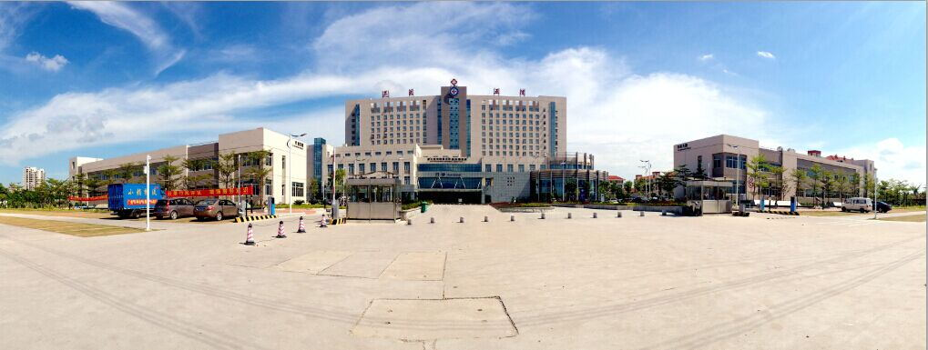
预立医疗照护计划-在医疗护理活动中的植入
Embedded Advance Care Planning into the health care service
邓仁丽
遵义医科大学第五附属（珠海) 医院
教授/博士/硕士生导师/护理部主任

Slide 2
目录
一、相关概念及背景
二、 ACP的临床运用
VIP for future care
4

Slide 3
目录
Part A Background

Slide 4
What are patients’ rights in hospital?
Do hospitals have a system to protect patients’ rights when they are terminally ill?

Slide 5
Tertiary hospital三甲医院
患者的合法权益 Patient’s Right
评审标准 Accreditation standards for tertiary hospital
1. 医院有相关制度保障患者或其亲近亲属、授权委托人充分了解其权利。The hospital has relevant systems to protect patients or their close relatives and authorize clients to fully understand their rights
1.1 患者或其近亲属、授权委托人对病情、诊断、医疗措施和医疗风险等具有知情选择的权利。医院有相关制度保证医务人员履行告知义务。Patients have the right to make informed choices about their conditions, diagnosis, treatment and risks. Hospitals have to ensure that medical staff perform the obligation to inform patients.

Slide 6
Tertiary hospital三甲医院
患者的合法权益 Patient’s Right
评审标准Accreditation standards for tertiary hospital
2. 应向患者或其近亲属、授权委托人说明病情及治疗方式、特殊治疗及处置，并获得其同意，说明内容应有记录。Informed consent should be obtained and recorded before special treatment.
3. 对医务人员进行知情同意和告知方面的培训，主管医师能够使用患者易懂的方式、语言与患者及其近亲属沟通，并履行书面同意手续。Training medical staff on informed consent and notification, they can use understandable language to communicate with patients, and complete written consent procedures.

Slide 7
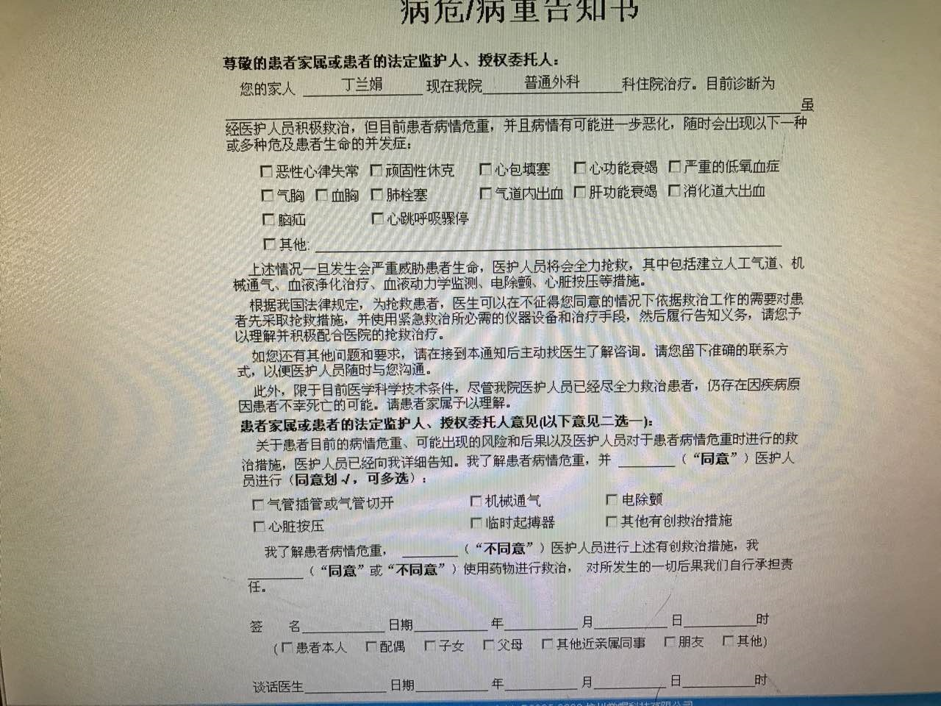
Tertiary hospital三甲医院
患者参与医疗安全Patient takes part in the process of decision making
评审标准Accreditation standards for tertiary hospital
针对患者疾病诊疗，为患者及其近亲属提供相关的健康知识教育，协助患者对诊疗方案做出正确理解与选择。Relevant health knowledge is provided for patients and to assist them to make a rational decision.

Slide 8
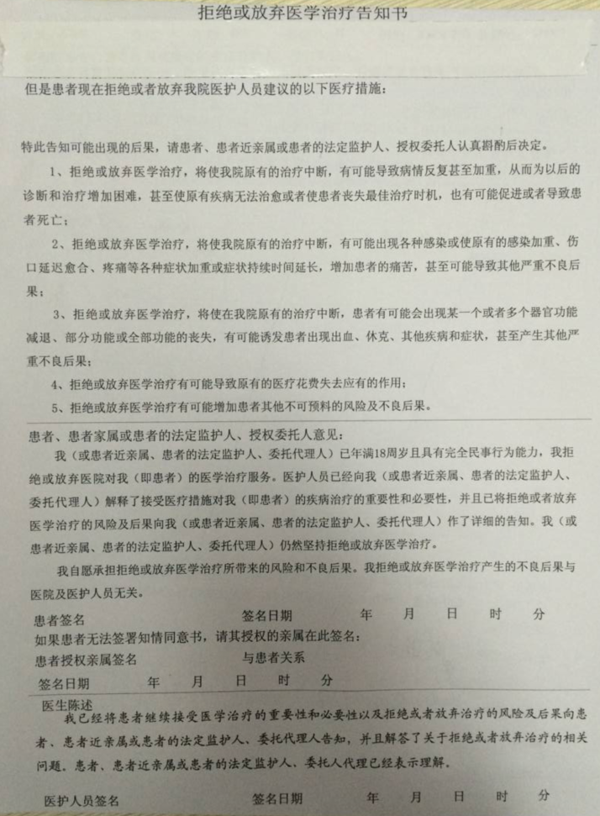
Timing of communication：patient in serious situation
Communicate to who：patient’s family
The treatment decision may not be the patient’s willingness
The aim of communication is to avoid risk from doctor 's
point of view

Slide 9
What can we do?

Slide 10
概 念(Definition)
Advance care planning is the process through which individuals are encouraged to clarify their personal values regarding future medical care, discuss their preferred care goals and preferences regarding end-of-life scenarios with their family members and health care team and document these preferences before they lose decisional capacity.
预立医疗照护计划鼓励个人阐明他们未来医疗意愿的价值观，与家庭成员和医疗团队讨论他们临终情景下的首选治疗目标和意愿，并在他们失去决策能力之前记录这些意愿的过程。
（Sudore et al., 2017；Rietjens et al., 2017)

Slide 11
相 互 关 系(Relationship)
患者
患者的临终选择需求
ACP
代
理
人
家
属
自主权
医务人员
ADs
(陈柳柳 et al. 2015)

Slide 12
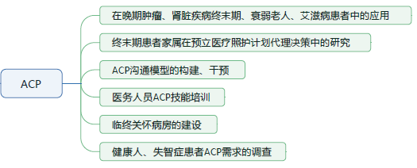

Slide 13
Part B ACP临床运用– “VIP for future care” model
晚期肿瘤患者“预立医疗照护计划”干预模式的构建及其实证研究
NSFC:71663064

Slide 14
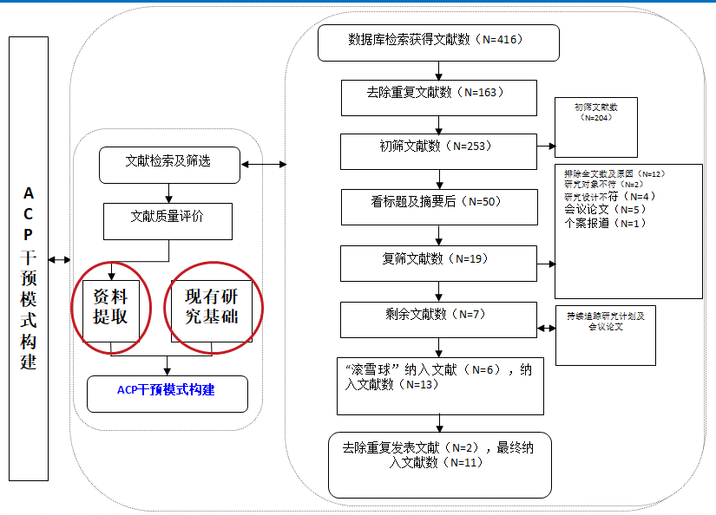
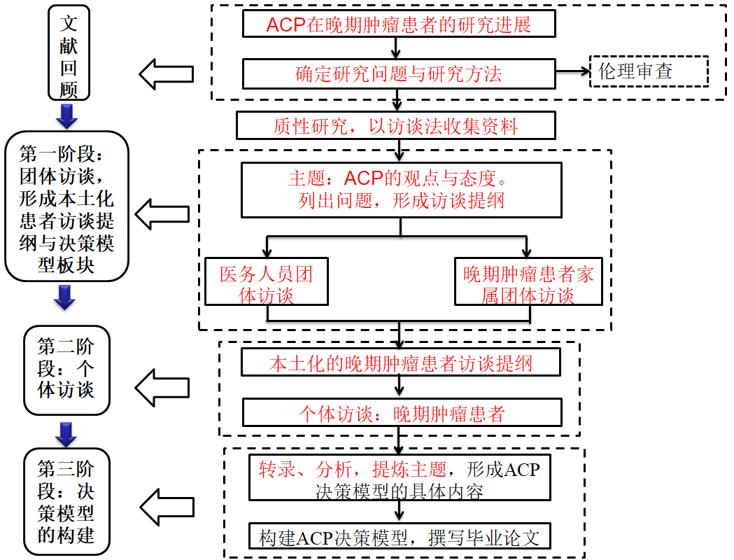
ACP沟通方案
组合沟通模型
VIP for Future Care
文献评阅
三次访谈
干预方案Intervention protocol
1.身临其境（通过视频介绍ACP）
2.患病经历
3.相约星期二（了解患者意愿）

Slide 15
ACP干预方案
VIP：是一个缩写词
Very Important Person
非常重要的人;
Video
Illness experience
Preference
VIP for Future Care
ACP沟通模型

Slide 16
01
杏林晚语（ Video ）
02
VIP for
Future Care
患病经历（Illness Experience）
03
相约星期二（Preference）

Slide 17
VIP for Future Care
第一阶段：（Video ）“杏林晚语”
采用视频的方法，介绍临终照护模式（延长生命照护、基本医疗照护、舒缓照护）以及ACP。
时长：5分30秒。采取管床护士一对一播放方式。

Slide 18
VIP for Future Care
住院经历：
患病过程、疼痛经历、用药、心理状况
抢救经历
对自己的身体状况及预后的了解程度
第二阶段：患病经历（Illness Experience）

Slide 19
VIP for Future Care
1
我希望谁来帮我决策
第三阶段
相约
星期二 Preference
2
我的治疗意愿
3
我想要的晚期生活
4
我的后事安排

Slide 20
辅助手段

Slide 21
谈 论 时 机
建立良好的关系
健 康 宣 教
患者身体和精神状态较好的时候

Slide 22
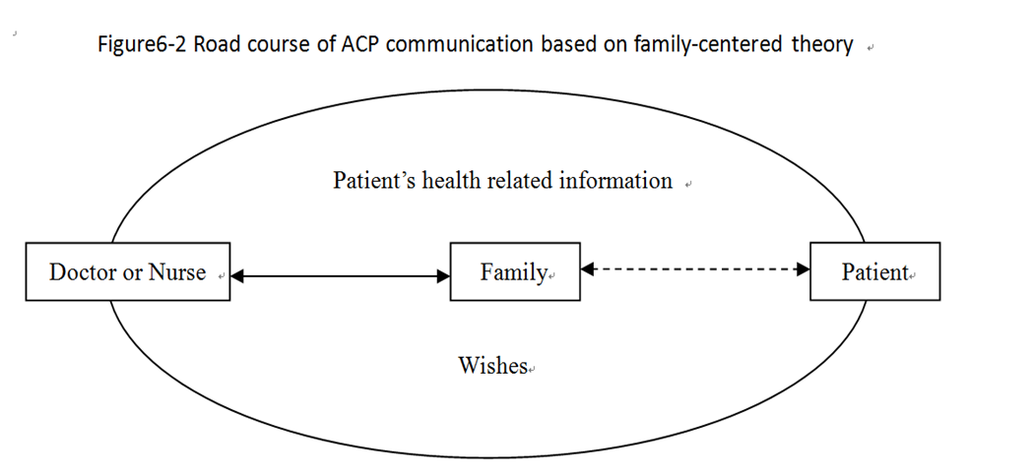
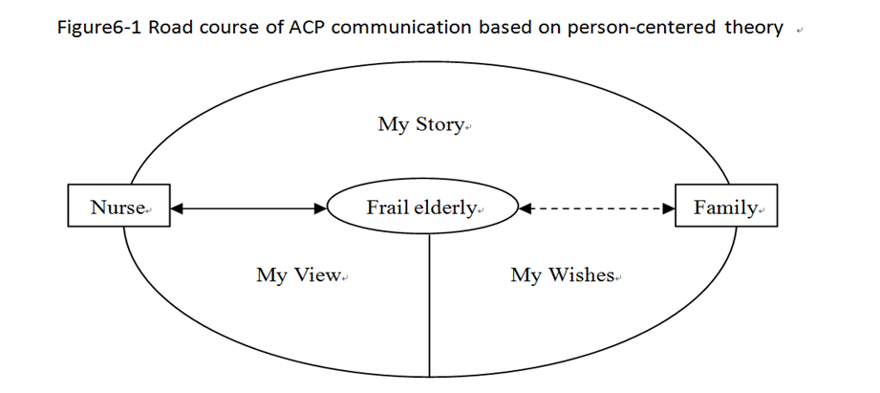
Path for acute care settings based on the family-centered theory
Path for long-term care facilities based on the person-centered theory
(Deng R L et al, 2018)

Slide 23
对策-培训
了解和尊重患者的意愿作为医务人员核心价值观，一个行之有效的预立医疗自主计划系统将会实现。
Respect wishes of people
an effective ACP system can be realized.

Slide 24
银杏代表长寿
黄叶代表从衰老到死亡
绿叶代表从出生到衰老
Ginkgo biloba stands for longevity
Yellow leave represents the life from aging to death
The green leave represents the passage from birth to old age

Slide 25
Thanks for listening

